Slide 1
Java SE 8 : Background
http://www.oracle.com/technetwork/java/javase/downloads/jdk8-downloads-2133151.html
Java release on March 18th, 2014
To set the PATH variable permanently, add the full path of the jdk1.8.0\bin directory to the PATH variable. Typically, this full path looks something like C:\Program Files\Java\jdk1.8.0\bin. Set the PATH variable as follows on Microsoft Windows:
Click Start, then Control Panel, then System.
Click Advanced, then Environment Variables.
Add the location of the bin folder of the JDK installation to the PATH variable in System Variables. The following is a typical value for the PATH variable:
C:\WINDOWS\system32;C:\WINDOWS;C:\Program Files\Java\jdk1.8.0\bin

Slide 2
Java SE 8 : Features
There are dozens of features added to Java 8, the most significant are mentioned below :
Memory Management
Functional Interface
Lambda Expression
Default Method
Method References
Stream API
Date Time API
Optional
Nashorn, A JavaScript Engine

Slide 3
Java SE 8 : Memory Management
Oracle has completely gotten rid of ‘PermGen’ and replaced it with Metaspace.
What is PermGen ?
Short form for Permanent Generation, PermGen is the memory area in Heap that is used by the JVM to store class and method objects. If your application loads lots of classes, PermGen utilization will be high. PermGen also holds ‘interned’ Strings
The size of the PermGen space is configured by the Java command line option -XX:MaxPermSize
Typically 256 MB should be more than enough of PermGen space for most of the applications
However, It is not unusal to see the error “java.lang.OutOfMemoryError: PermGen space“ if you are loading unusual number of classes.
Gone are the days of OutOfMemory Errors due to PermGen space. With Java 8, there is NO PermGen. That’s right. So no more OutOfMemory Errors due to PermGen
The key difference between PermGen and Metaspace is this: while PermGen is part of Java Heap (Maximum size configured by -Xmx option), Metaspace is NOT part of Heap. Rather Metaspace is part of Native Memory (process memory) which is only limited by the Host Operating System.

Slide 4
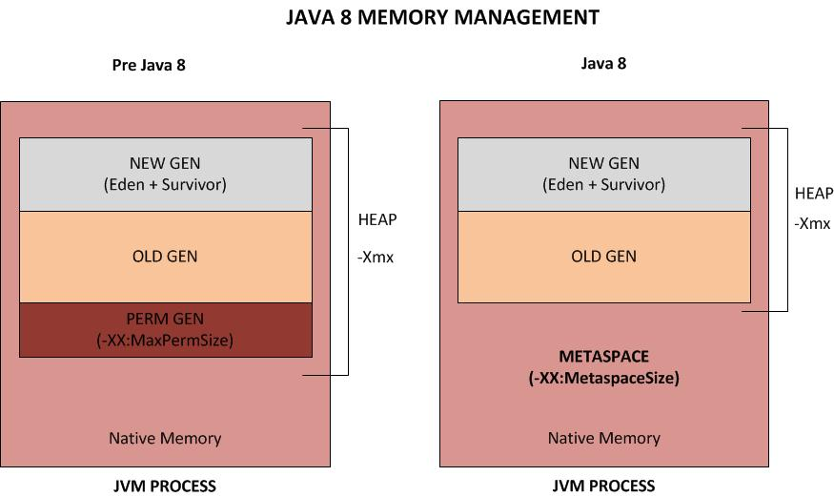

Slide 5
So, what is the significance of this change?
While you will NOT run out of PermGen space anymore (since there is NO PermGen), you may consume excessive Native memory making the total process size large. The issue is, if your application loads lots of classes (and/or interned strings), you may actually bring down the Entire Server (not just your application). Why ? Because the native memory is only limited by the Operating System. This means you can literally take up all the memory on the Server. Not good.
It is critical that you add the new option ” -XX:MetaspaceSize ” which sets the Maximum Metaspace size for your application.
Note that it is no longer sufficient to just monitor the Heap Size. You must also monitor the Metaspace which you can do by just keeping an eye on the ‘process size’ using your Operating System utilities (Example: ‘top’ in Unix/Linux, ‘Task Manager’ in Windows).

Slide 6
Bonus Tip:
You can use the jmap command to print out Memory statistics of your current pre Java 8 application.
jmap -permstat <PID>
There you have it. With Java 8, PermGen is gone and Metaspace is in. Metaspace is part of Native Memory and NOT part of Java Heap. While this change may not be significant during development stage of the application, it is critical to consider this when going to production as you might not only bring down your application but bring down the entire server if your application eats up excessive Metaspace.

Slide 7
Java SE 8 : Functional Interface
An interface which has Single Abstract Method can be called as Functional Interface.
Runnable, Comparator are some of the examples for Functional Interface.
We can implement these Functional Interfaces by using Lambda expression.
Syntax
@FunctionalInterface
public interface FunctionalInterfaceTest
{ void display(); }

Slide 8
Do’s and Don'ts in functional interfaces
A) only one abstract method is allowed in any functional interface. Second abstract method is not permitted in a functional interface. If we remove @FunctionInterface annotation then we are allowed to add another abstract method, but it will make the interface non-functional interface.
B) A functional interface is valid even if the @FunctionalInterface annotation would be omitted. It is only for informing the compiler to enforce single abstract method inside interface.
C) Conceptually, a functional interface has exactly one abstract method. Since default methods have an implementation, they are not abstract. Since default methods are not abstract you’re free to add default methods to your functional interface as many as you like.

Slide 9
Java SE 8 : Default Method
Java 8 introduces “Default Method” or (Defender methods) new feature, which allows developer to add new methods to the interfaces without breaking the existing implementation of these interface.
It provides flexibility to allow interface define implementation which will use as default in the situation where a concrete class fails to provide an implementation for that method.
Difference Between Default Method and Regular Method
Default Method is different from the regular method in the sense that default method comes with default modifier.
Additionally, methods in classes can use and modify method arguments as well as the fields of their class but default method on the other hand, can only access its arguments as interfaces do not have any state.

Slide 10
When to Use Default Method Over Abstract Classes
Abstract classes versus interfaces in Java 8
After introducing Default Method, it seems that interfaces and abstract classes are same. However, they are still different concept in Java 8.
Abstract class can define constructor. They are more structured and can have a state associated with them. While in contrast, default method can be implemented only in the terms of invoking other interface methods, with no reference to a particular implementation's state. Hence, both use for different purposes and choosing between two really depends on the scenario context.
public interface InterfaceA {
default void defaultMethod(){
System.out.println("Interface A default method");
}
}

Slide 11
Java SE 8 : Lembda Expression
Lambda expressions are used primarily to define inline implementation of a functional interface, i.e., an interface with a single method only.
Lambda expression eliminates the need of anonymous class and gives a very simple yet powerful functional programming capability to Java.
Syntax:
(parameters) -> {body}
Example
(x,y) -> { x + y }

Slide 12
Java SE 8 : Method References
Some times, A lambda expression do nothing but just calls a method which is already defined. In this case, to be more lazy to write, You can use method references.
Method references are just compact and more readable form of a lambda expression for already written methods. “::” operator is used for method reference.
When to use method reference :
When a Lambda expression is invoking already defined method, you can replace it with reference to that method.
When you can not use Method reference :
You can not pass arguments to the method reference. for example, you can not use method reference for following lambda.
IsReferable demo = () -> ReferenceDemo.commonMethod("Argument in method.");

Slide 13
Use of Method Reference’s :
Kind | Example
Reference to a static method | ContainingClass::staticMethodName
Reference to an instance method of a particular object | containingObject::instanceMethodName
Reference to an instance method of an arbitrary object of a particular type | ContainingType::methodName
Reference to a constructor | ClassName::new

Slide 14
Java SE 8 : Nashorn JVM JavaScript Engine
The Nashorn Javascript Engine is part of Java SE 8 and competes with other standalone engines like Google V8 (the engine that powers Google Chrome and Node.js). Nashorn extends Javas capabilities by running dynamic javascript code natively on the JVM.
We will learn how to call javascript functions from java code and vice versa. At the end you're ready to integrate dynamic scripts in your daily java business.
The Nashorn javascript engine can either be used programmatically from java programs or by utilizing the command line tool jjs, which is located in $JAVA_HOME/bin.

Slide 15
$ cd /usr/bin
$ ln -s $JAVA_HOME/bin/jjs jjs
$ jjs
jjs> print('Hello World');
In order to evaluate javascript code from java, you first create a nashorn script engine by utilizing the javax.script package already known from Rhino (Javas legacy js engine from Mozilla).
Javascript code can either be evaluated directly by passing javascript code as a string as shown above. Or you can pass a file reader pointing to your .js script file:
ScriptEngine engine = new ScriptEngineManager().getEngineByName("nashorn");
engine.eval(new FileReader("script.js"));

Slide 16
Java SE 8 : Optional
public final class Optional<T>
extends Object
A container object which may or may not contain a non-null value. If a value is present, isPresent() will return true and get() will return the value.
Additional methods that depend on the presence or absence of a contained value are provided, such as orElse() (return a default value if value not present) and ifPresent() (execute a block of code if the value is present).
This is a value-based class; use of identity-sensitive operations (including reference equality (==), identity hash code, or synchronization) on instances of Optional may have unpredictable results and should be avoided.

Slide 17
Java SE 8 : Date & Time
Why do we need a new date and time library?
For example, the existing classes (such as java.util.Date and SimpleDateFormatter) aren’t thread-safe, leading to potential concurrency issues for users—not something the average developer would expect to deal with when writing date-handling code.
Some of the date and time classes also exhibit quite poor API design. For example, years in java.util.Date start at 1900, months start at 1, and days start at 0—not very intuitive.
In order to address these problems and provide better support in the JDK core, a new date and time API, which is free of these problems, has been designed for Java SE 8.
Java.time.* package is used for date and time

Slide 18
Java SE 8 : Streams
The key new library abstraction introduced in Java SE 8 is a stream, defined in package java.util.stream. (There are several stream types; Stream<T> represents a stream of object references, and there are specializations such as IntStream to describe streams of primitives.) A stream represents a sequence of values, and exposes a set of aggregate operations that allow us to express common manipulations on those values easily and clearly. The libraries provide convenient ways to obtain stream views of collections, arrays, and other data sources

Slide 19
Java SE 8 : Stream Operations
he final operation to consume the stream is a terminal operation. Examples of terminal operators include forEach, reduce and collect.
The pipeline of operations are classified as intermediate and terminal operators.
Intermediate operators apply logic so the incoming stream produces yet another stream. filters and maps are the example of it.
the final operation to consume the stream is a terminal operation. Examples of terminal operators include forEach, reduce and collect.
Filters : Filters are intermediate operations that produce another stream with the same event properties by removing the unwanted items.
Maps : A stream of events can be transformed into another event by using mapping functionality. A transform operation can be performed on a stream by invoking the map method
Collect : We can also create additional data storage from the stream by using the collect method. For example, here’s what the code would look like if we needed to have some trades tapped into a list:
Parallel streams : Distributing and performing parallel operations on collections can lead to threading issues as they are not “thread-safe” by nature

Slide 20
Java SE 8 : QA
he final operation to consume the stream is a terminal operation. Examples of terminal operators include forEach, reduce and collect.

